Slide 1
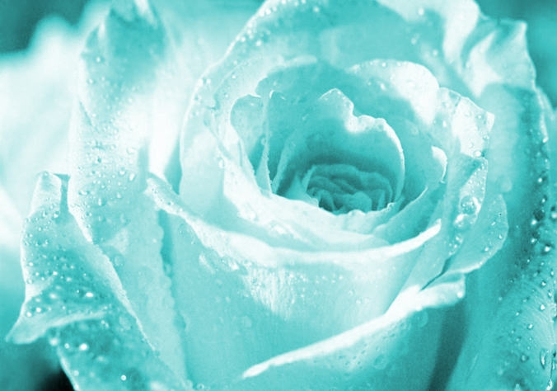
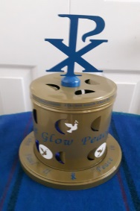
The Circles of Rosary
Opening Prayer
Family
School
Church
In the name of the Father, of the Son, and of the Holy Spirit.
Dearest Mary, Jesus Christ,
St. John Paul II, and St Teresa of Calcutta, our peace models,
Enlighten us in caring and in loving our family
Help us to care, respect and love our siblings, Mom, Dad and elders.
Show us how to give without expecting a return or favour
Enlighten us how to value our family
With honesty, respect and peace at all times
Amen
© The Circles of Rosary 905 896 2958

Slide 2
The Apostles’ Creed
He ascended into heaven and is
seated at the right hand of God
the Father Almighty.
From there, He will come again
to judge the living and the dead.
I believe in the Holy Spirit,
the holy Catholic Church,
the communion of saints,
the forgiveness of sins,
the resurrection of the body,
and life everlasting.
Amen.
I believe in God, The Father Almighty, creator of heaven and earth,
And in Jesus Christ, his only Son, our Lord,
Who was conceived by the Holy Spirit,
born of the Virgin Mary,
Suffered under Pontius Pilate,
was crucified, died, and was buried.
He descended into hell;
on the third day,
He rose again from the dead;

Slide 3
Our Father
Our Father, who art in Heaven,
Hallowed be thy name.
Thy kingdom come, thy will be done,
on earth as it is in Heaven.
Give us this day our daily bread,
and forgive us our trespasses,
As we forgive those who trespass against us
And lead us not into temptation
But deliver us from evil.
Amen.

Slide 4
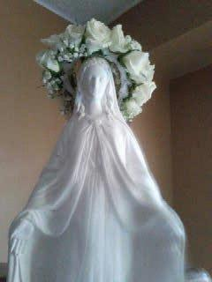
Hail Mary
Hail Mary, full of grace!
The Lord is with thee.
Blessed are thou amongst women,
And blessed is the fruit of thy womb, Jesus.
Holy Mary, Mother of God,
Pray for us sinners
Now and until the hour of death.
Amen.

Slide 5
Glory Be
Glory be to the Father,
And to the Son,
And to the Holy Spirit
As it was in the beginning,
Is now, and ever shall be
World without end.
Amen.

Slide 6
Fatima Prayer
O my Jesus,
Forgive us our sins,
Save us from the fires of hell,
Lead all souls to Heaven,
Especially those who need most of thy mercy.

Slide 7
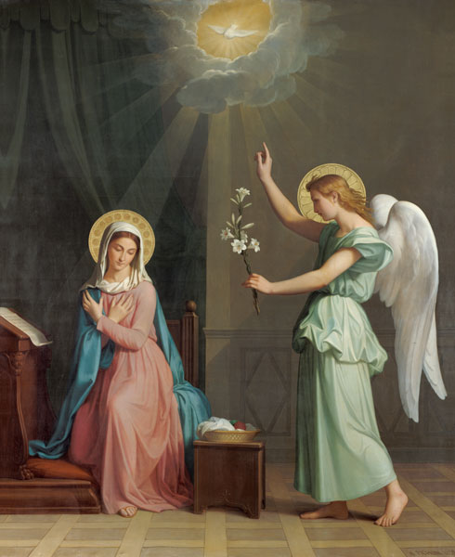
The First Joyful Mystery
Mondays and Saturdays
The Annunciation
Obtain for us, dearest Mother from your Divine son, the grace and power of the Holy Spirit
to welcome the Word of God and accomplish God’s will and plan.
Intentions _________________

Slide 8
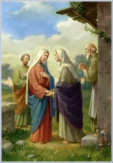
The Second Joyful Mystery
The Visitation
Obtain for us, dearest Mother, from your Divine Son, the grace and power of the Holy Spirit
to reach out to others and bring Christ to them.
Intentions ___________________

Slide 9
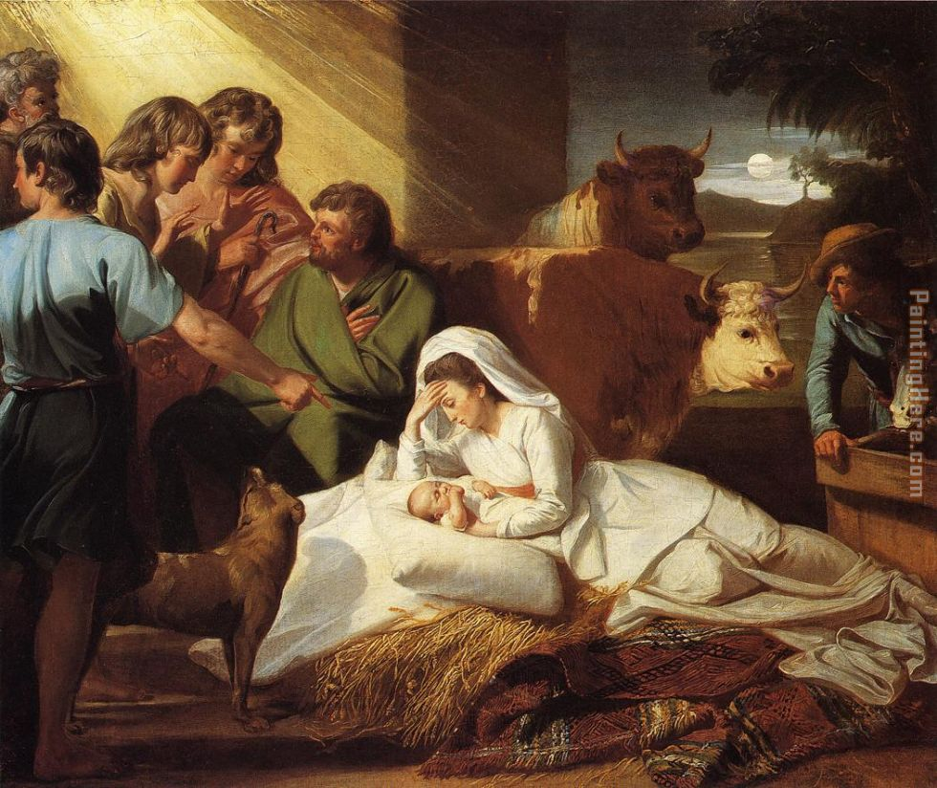
The Third Joyful Mystery
The Birth of Christ in Bethlehem
Obtain for us dearest Mother, from your Divine Son, the grace and power of the Holy Spirit
to be more like Christ in the
spirit of humility and poverty.
Intentions ___________________

Slide 10
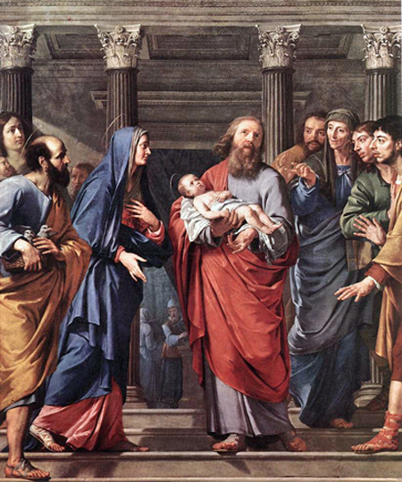
The Fourth Joyful Mystery
The Presentation of
the Child Jesus in the Temple
Obtain for us, dearest Mother from your Divine Son, the grace and power of the Holy Spirit
to offer all that we are and have joyfully.
Intentions ____________________

Slide 11
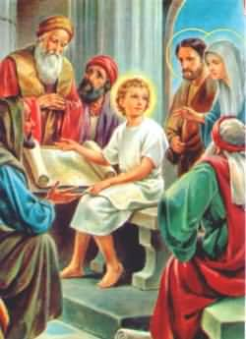

The Fifth Joyful Mystery
The Finding of the Child Jesus
in the Temple
Obtain for us, dearest Mother from your Divine Son, the grace and power of the Holy Spirit
to break the habits of sins and evil tendencies and to grow in the wisdom and grace of your Divine Son.
Intentions __________________

Slide 12
Hail Holy Queen
Hail Holy Queen, Mother of Mercy,
hail our life, our sweetness and our hope,
to thee do we cry, poor banished children of Eve;
to thee do we send up our sighs, mourning, and weeping in this valley of tears.
Turn then, most gracious Advocate, thine eyes of mercy toward us,
and after this our exile,
show unto us the blessed fruit of thy womb, Jesus.
O Clement, O loving, O sweet Virgin Mary
Leader: Pray for us, O holy Mother of God
Response: That we may be made worthy of the promises of Christ

Slide 13
Act of Consecration
O God, whose only begotten Son,
by His life, death, and resurrection,
has purchased for us the rewards of eternal salvation.
Grant we beseech Thee
that while meditating on these mysteries
of the most Holy Rosary of the Blessed Virgin Mary,
that we may both imitate what they contain,
and obtain what they promise,
through Christ our Lord. Amen.

Slide 14
The Circles of Rosary
Closing Prayer
School
Family
church
Thank you, Lord, for blessing our home
A place of safety, comfort and peace
A family of unconditional love, forgiveness, mercy and acceptance.
Help our family to be peacemakers
like Mary, Jesus, St. John Paul II and St. Teresa of Calcutta.
Please help us to remember
that peace and love around the world starts with you and me.
Amen

Slide 15

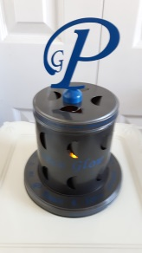
Let there be peace on earth
and let it begin with me
Let there be peace on earth,
the peace that was meant to be
With God as our Father,
children all are we
Let us walk with each other
in perfect harmony
Let peace begin with me,
let this be the moment now
With every step I take,
let this be my solemn vow
To take each moment . and live each moment
in peace eternally
Let there be peace on earth and let it begin with me
- Jill Jackson & Sy Miller-

